Slide 1
Flex and Grid

Slide 2
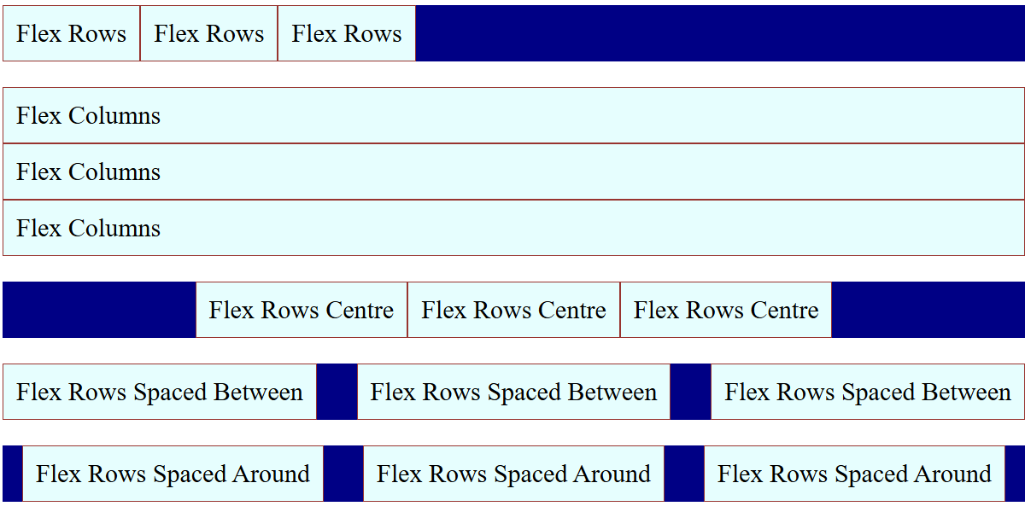
Using Flexbox - Introduction
Flexbox is a one-dimensional layout system for arranging items in rows or columns.
It helps with
alignment,
spacing, and
responsiveness.

Slide 3
Flex Container Properties
flex-direction: Sets layout direction — use row (horizontal) or column (vertical).
justify-content: Aligns items along the main axis — flex-start, center, or space-between.
align-items: Aligns items on the cross axis — stretch fills space, center aligns neatly.
.container {
display: flex;
flex-direction: row | column;
justify-content: flex-start | center | space-between;
align-items: stretch | center;
}
view

Slide 4
Flex Item Properties
align-self: Overrides align-items for a single item — e.g., center, flex-start, stretch.
order: Controls item position — lower numbers appear first, default is 0.
.item {
flex: 1; /* grow */
align-self: center; /* overrides align-items */
order: 2; /* item position */
}
view

Slide 5
Example: Horizontal Navigation Bar
<style>
nav {
display: flex;
justify-content: space-around;
}
</style>
<nav>
<a>Home</a>
<a>About</a>
<a>Contact</a>
</nav>
view

Slide 6
Responsive Card Layout
flex-wrap: Allows items to wrap onto multiple lines instead of shrinking use wrap for responsiveness.
flex: 1 1 calc(33.33% - 20px)
1 → item can grow
1 → item can shrink
calc(33.33% - 20px) → base size (1/3 width minus gap)
.cards {
display: flex;
flex-wrap: wrap;
gap: 20px;
}
.card {
flex: 1 1 calc(33.33% - 20px);
min-width: 250px;
}
view

Slide 7
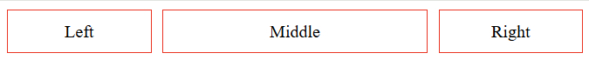
Setting proportional size
This example shows how to set double space for one element (flex:2)
Flex:1
10px
Flex:2
10px
Flex: 1
<body>
<div class="container">
<div class="item">Left</div>
<div class="item middle">Middle</div>
<div class="item">Right</div>
</div>
</body>
.container {
display: flex;
gap: 10px;
}
.item {
flex: 1;
}
.middle {
flex: 2;
}

Slide 8
Flex Tips
Use `flex-wrap: wrap` for responsiveness
Combine `gap` with `flex` for consistent spacing
Test flex behavior at different screen widths

Slide 9
Lab – Flex
Experiment with different flex attributes

Slide 10
CSS Grid - Introduction
Grid is a two-dimensional layout system allowing precise placement of items in rows and columns.

Slide 11
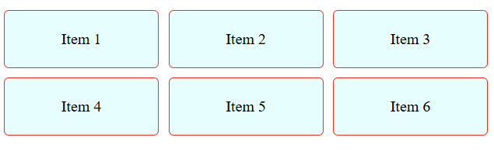
Grid Container Properties
.container {
display: grid;
grid-template-columns: repeat(3, 1fr);
grid-gap: 10px;
}
<div class="container">
<div class="item">Item 1</div>
<div class="item">Item 2</div>
<div class="item">Item 3</div>
<div class="item">Item 4</div>
<div class="item">Item 5</div>
<div class="item">Item 6</div>
</div>
view

Slide 12
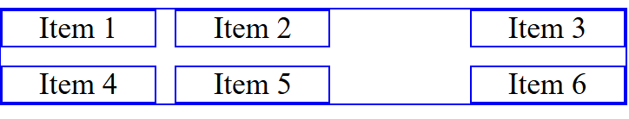
Basic Grid Layout
.container {
display: grid;
grid-template-columns: 1fr 2fr 1fr;
}
<div class="container">
<div class="item1">Item 1</div>
<div class="item2">Item 2</div>
<div class="item3">Item 3</div>
<div class="item4">Item 4</div>
</div>
view

Slide 13
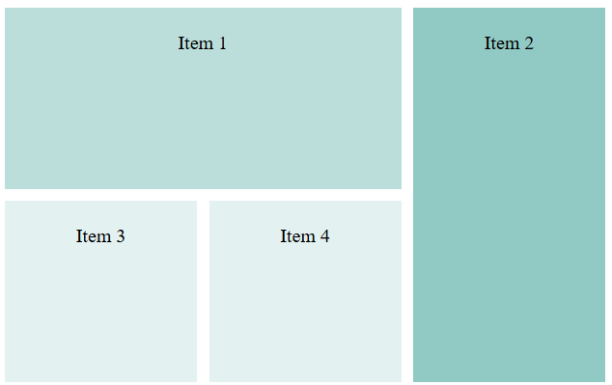
Grid Item positioning
.container {
display: grid;
grid-template-columns: repeat(3, 1fr);
grid-template-rows: repeat(2, 150px);
gap: 10px;
}
.item1 {
grid-column: 1/3;
grid-row: 1/2;
}
.item2 {
grid-column: 3/4;
grid-row: 1/3;
}
<div class="container">
<div class="item1">Item 1</div>
<div class="item2">Item 2</div>
<div class="item3">Item 3</div>
<div class="item4">Item 4</div>
</div>
view

Slide 14
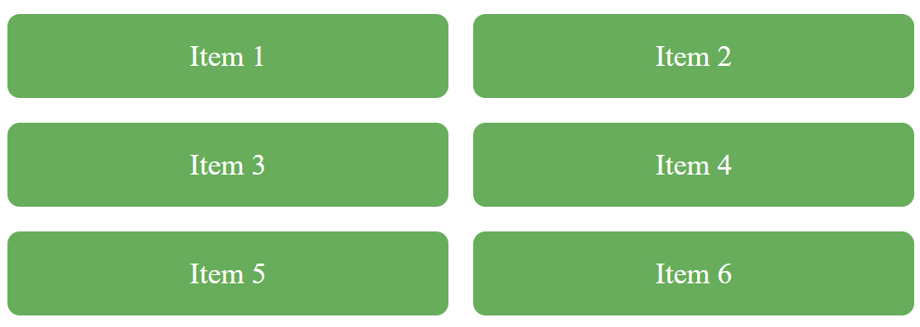
Responsive Grid Gallery
Each column should be at least 200px wide, but if there is more room, let it expand and share space equally.
Below shows what happens when display shrinks.
.container {
display: grid;
grid-template-columns: repeat(auto-fit, minmax(200px, 1fr));
gap: 1rem;
}
view

Slide 15
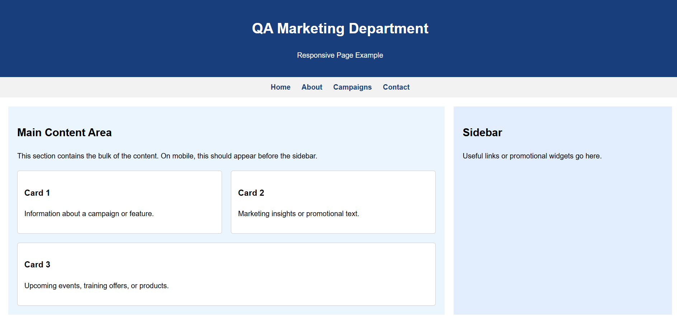
Lab - Combined Layout
Create a page as seen below Header: Flexbox - Main section: Grid with sidebar and content Footer: Flex with centered text and icons
Use media queries for mobile responsiveness.

Slide 16
Summary
In this chapter, you discovered how to use Flex and Grids to create a Responsive web page

